Slide 1
Session No 1
Learning Objectives and Introduction to python

Slide 2
Learning Objectives

Slide 3
Learning Objectives
Python
Core Python
OOP
Numpy Pandas Matplotlib
Machine Learning
Supervised Machine Learning
Unsupervised Machine

Slide 4
Why take this course?

Slide 5
Desktop First -> Web First -> Mobile First -> Intelligence First

Slide 6
Surprise! Machine learning jobs are high-paying and in-demand
&
Huge Amount of Research

Slide 7
Why Python for Machine Learning?

Slide 8
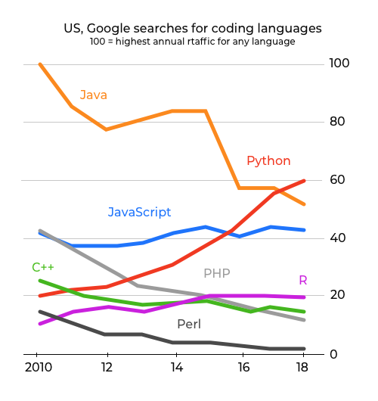
Popularity
This graph shows python’s popularity in terms of google searches

Slide 9
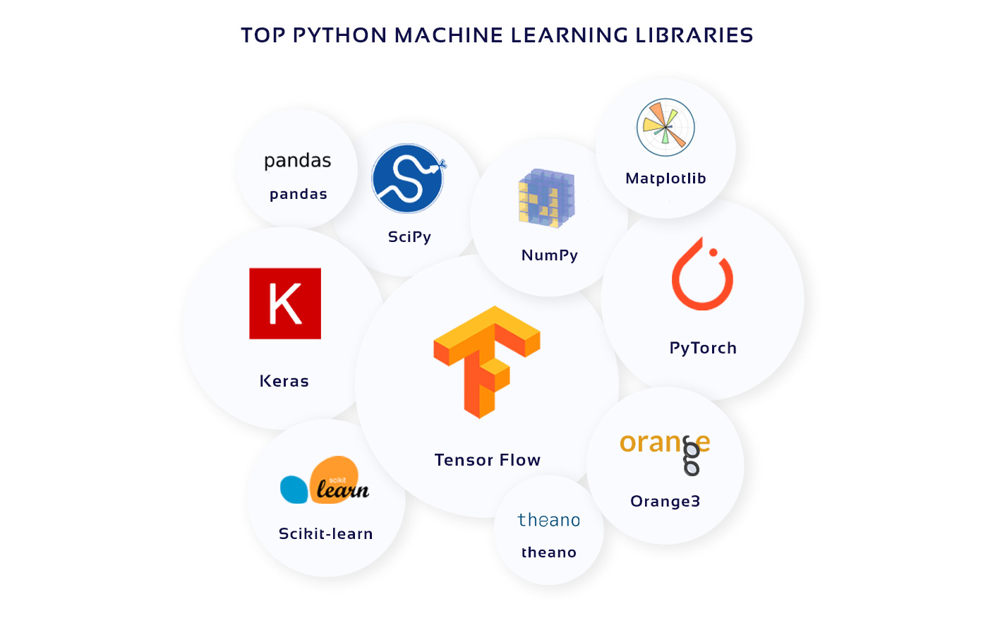
Libraries and Frameworks
Python has extensive range of libraries and framework for machine learning
Keras, TensorFlow, and Scikit-learn for machine learning
SciPy for advanced computing
Matplotlib for data visualization
Pandas for general-purpose data analysis
NumPy for scientific computing and data analysis

Slide 10

Readability
Easy to Read which makes debugging easy and making change simple

Slide 11
Introduction to Python

Slide 12
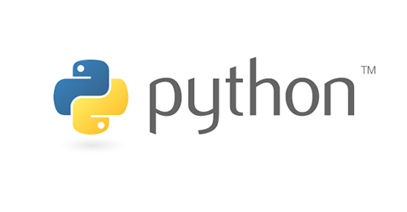
What is python?
Python is an interpreted, object-oriented, high-level programming language with dynamic semantics.
Python is relatively simple so easy to learn.

Slide 13
History of Python
Guido Van Rossum Created Python
It was created from ABC a programming language
It was started as hobby project
Its name is taken from BBC’s popular show Monty Python’s Flying Circus

Slide 14
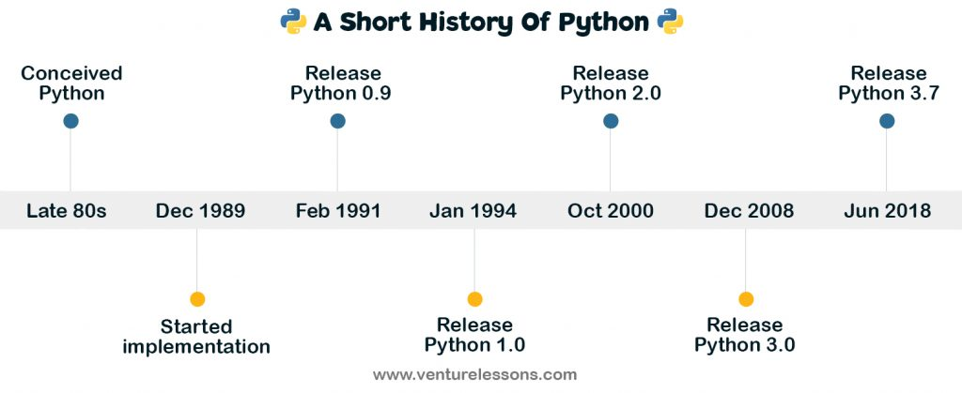

Slide 15
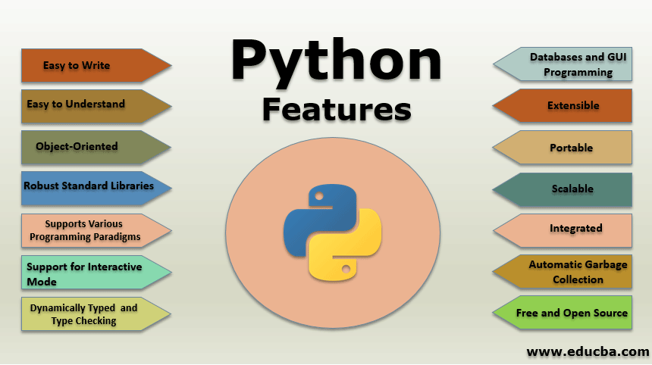

Slide 16
Module 1 Core Python

Slide 17
Getting started with Python
Download and Install Python 3
Download and install Sublime, VSCode, Notepad++ or any text editor of your choice

Slide 18
Python is an experiment in how much freedom programmers need. Too much freedom and nobody can read another's code; too little and expressiveness is endangered.
Guido Van Rossum

Slide 19
Programming modes
There are two python programming modes
Interactive mode programming
Script mode programming

Slide 20
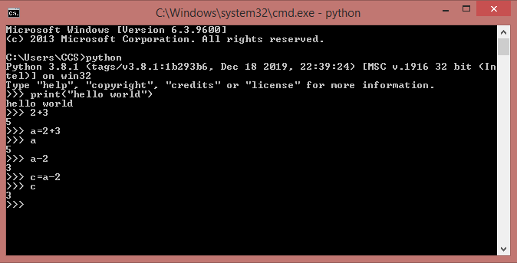
Interactive mode programming

Slide 21
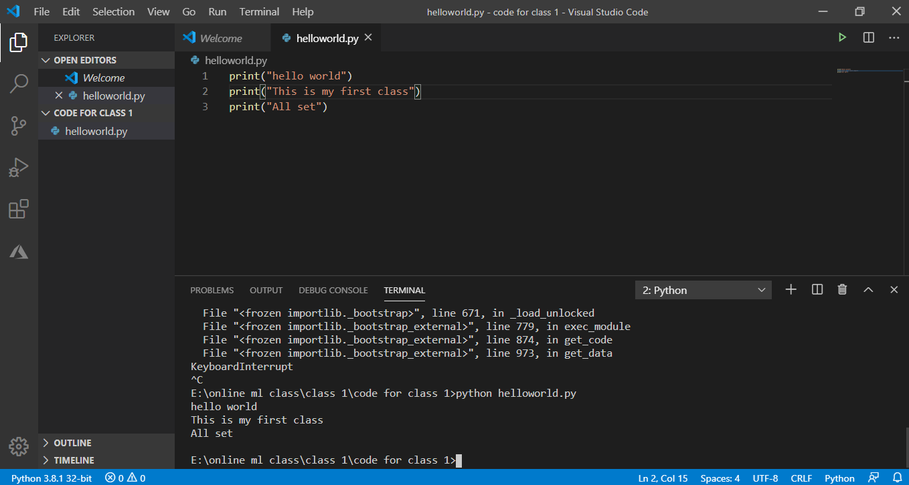
Script mode programming

Slide 22
Assigning Value to Variable

Slide 23
Data Types
Python has five standard data types −
Numbers
String
List
Tuple
Dictionary

Slide 24
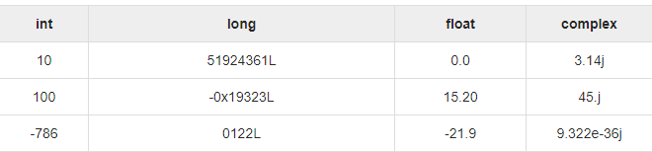

Slide 25
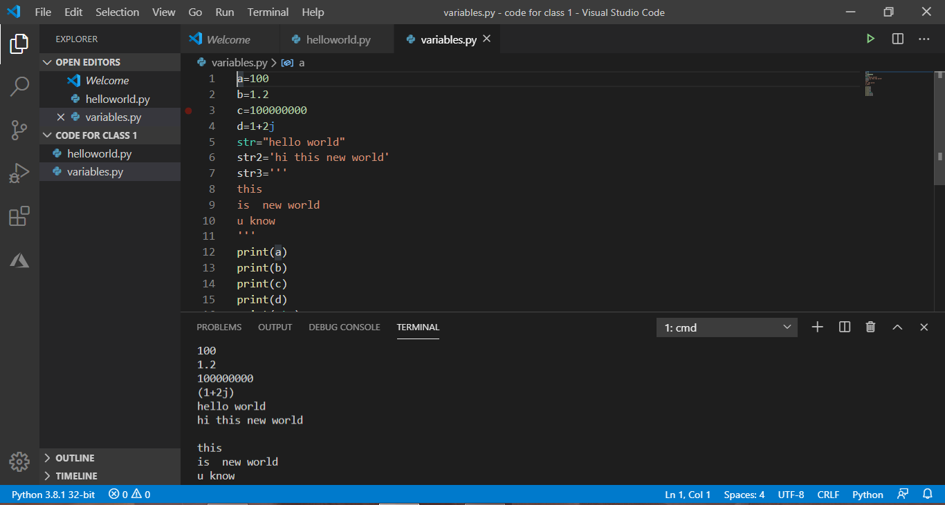

Slide 26
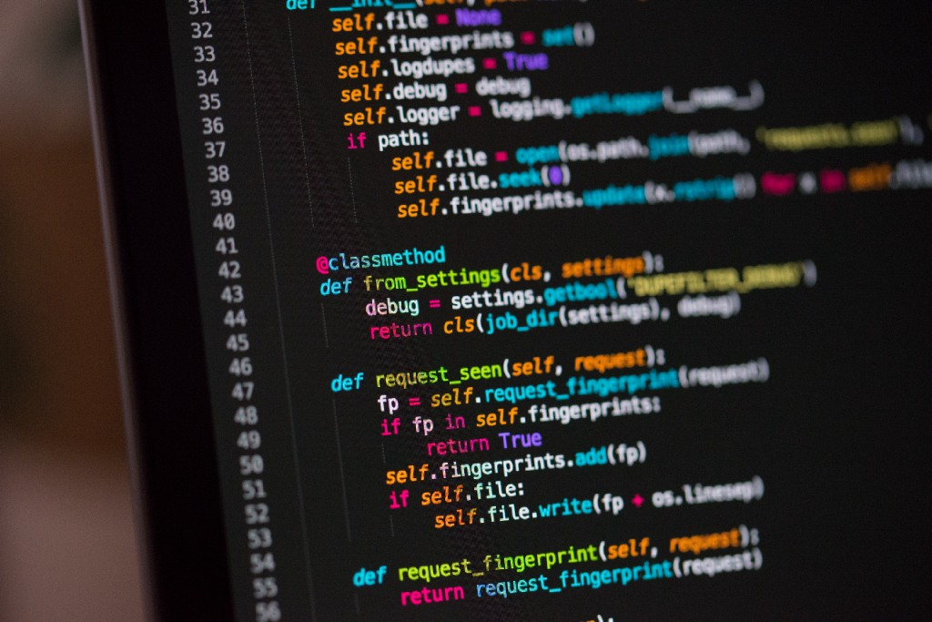
Thanks!
owais.leghari@hotmai.com
Code Repository
LinkedIn

